Slide 1
Chapter 5
The LC-3

Slide 2
Instruction Set Architecture
ISA = All of the programmer-visible components
and operations of the computer
  memory organization
    address space -- how may locations can be addressed?
    addressibility -- how many bits per location?
  register set
    how many? what size? how are they used?
  instruction set
    opcodes
    data types
    addressing modes
ISA provides all information needed for someone that wants to
write a program in machine language
(or translate from a high-level language to machine language).

Slide 3
LC-3 Overview: Memory and Registers
Memory
  address space: 2¹⁶ locations (16-bit addresses)
  addressability: 16 bits
Registers
  temporary storage, accessed in a single machine cycle
    accessing memory generally takes longer than a single cycle
  eight general-purpose registers: R0 - R7
    each 16 bits wide
    how many bits to uniquely identify a register?
  other registers
    not directly addressable, but used by (and affected by) instructions
    PC (program counter), condition codes

Slide 4
LC-3 Overview: Instruction Set
Opcodes
  15 opcodes
  Operate instructions: ADD, AND, NOT
  Data movement instructions: LD, LDI, LDR, LEA, ST, STR, STI
  Control instructions: BR, JSR/JSRR, JMP, RTI, TRAP
  some opcodes set/clear condition codes, based on result:
    N = negative, Z = zero, P = positive (> 0)
Data Types
  16-bit 2’s complement integer
Addressing Modes
  How is the location of an operand specified?
  non-memory addresses: immediate, register
  memory addresses: PC-relative, indirect, base+offset

Slide 5
Operate Instructions
Only three operations: ADD, AND, NOT
Source and destination operands are registers
  These instructions do not reference memory.
  ADD and AND can use “immediate” mode,
  where one operand is hard-wired into the instruction.
Will show dataflow diagram with each instruction.
  illustrates when and where data moves
  to accomplish the desired operation

Slide 6
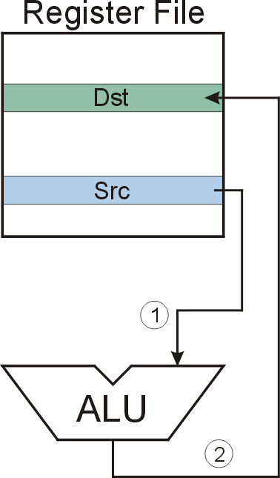
NOT (Register)
Note: Src and Dst
could be the same register.

Slide 7
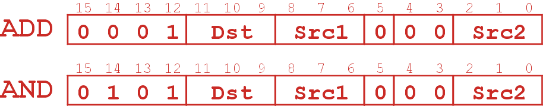
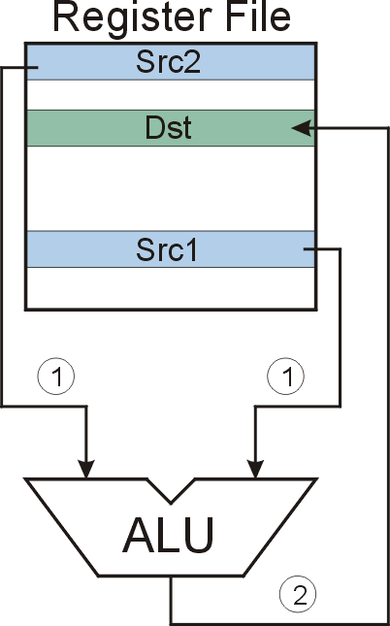
ADD/AND (Register)
this zero means “register mode”

Slide 8
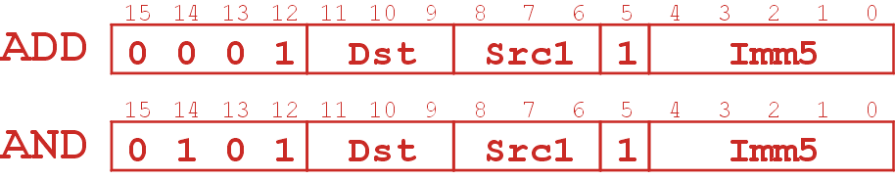
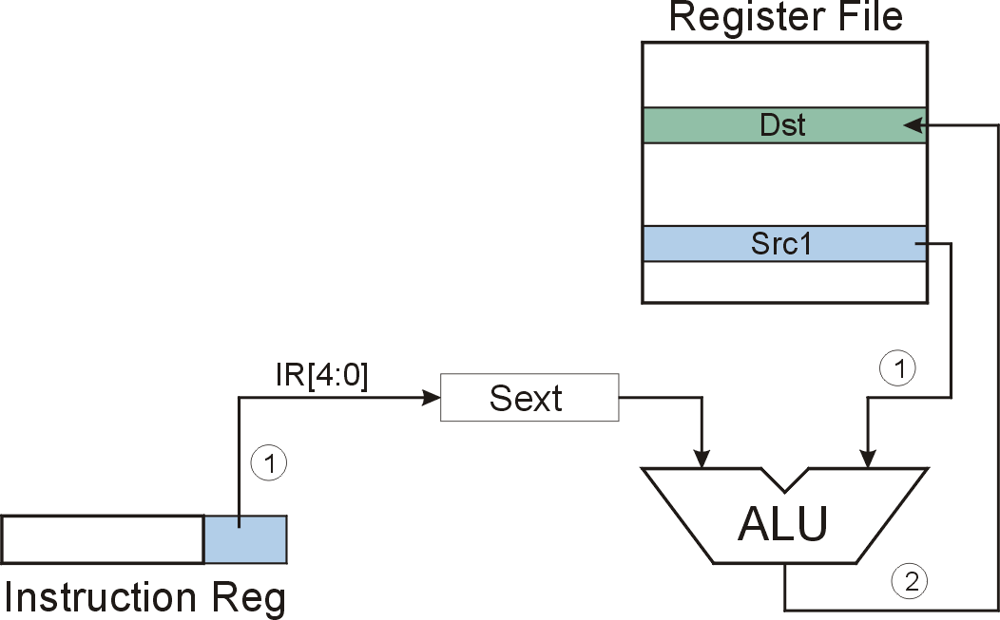
ADD/AND (Immediate)
this one means “immediate mode”
Note: Immediate field is
sign-extended.
Notes:
.

Slide 9
Using Operate Instructions
With only ADD, AND, NOT…
  How do we subtract?
  How do we OR?
  How do we copy from one register to another?
  How do we initialize a register to zero?
Notes:
Subtract: R3 = R1 - R2
Take 2’s complement of R2, then add to R1.
(1) R2 = NOT(R2)
(2) R2 = R2 + 1
(3) R3 = R1 + R2
OR: R3 = R1 OR R2
Use DeMorgan’s Law -- invert R1 and R2, AND, then invert result.
(1) R1 = NOT(R1)
(2) R2 = NOT(R2)
(3) R3 = R1 AND R2
(4) R3 = NOT(R3)
Register-to-register copy: R3 = R2
R3 = R2 + 0 (Add-immediate)
Initialize to zero: R1 = 0
R1 = R1 AND 0 (And-immediate)

Slide 10
Using Operate Instructions
With only ADD, AND, NOT…
  How do we subtract?
  How do we OR?
  How do we copy from one register to another?
  How do we initialize a register to zero?
Notes:
Subtract: R3 = R1 - R2
Take 2’s complement of R2, then add to R1.
(1) R2 = NOT(R2)
(2) R2 = R2 + 1
(3) R3 = R1 + R2
OR: R3 = R1 OR R2
Use DeMorgan’s Law -- invert R1 and R2, AND, then invert result.
(1) R1 = NOT(R1)
(2) R2 = NOT(R2)
(3) R3 = R1 AND R2
(4) R3 = NOT(R3)
Register-to-register copy: R3 = R2
R3 = R2 + 0 (Add-immediate)
Initialize to zero: R1 = 0
R1 = R1 AND 0 (And-immediate)

Slide 11
Data Movement Instructions
Load -- read data from memory to register
  LD: PC-relative mode
  LDR: base+offset mode
  LDI: indirect mode
Store -- write data from register to memory
  ST: PC-relative mode
  STR: base+offset mode
  STI: indirect mode
Load effective address -- compute address,
save in register
  LEA: immediate mode
  does not access memory

Slide 12


PC-Relative Addressing Mode
Want to specify address directly in the instruction
  But an address is 16 bits, and so is an instruction!
  After subtracting 4 bits for opcode
  and 3 bits for register, we have 9 bits available for address.
Solution:
  Use the 9 bits as a signed offset from the current PC.
9 bits:
Can form any address X, such that:
Remember that PC is incremented as part of the FETCH phase;
This is done before the EVALUATE ADDRESS stage.

Slide 13
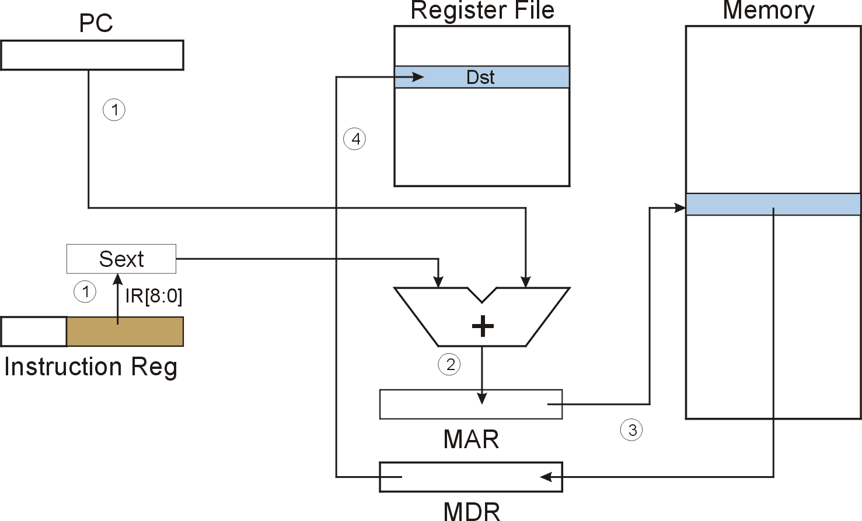
LD (PC-Relative)

Slide 14
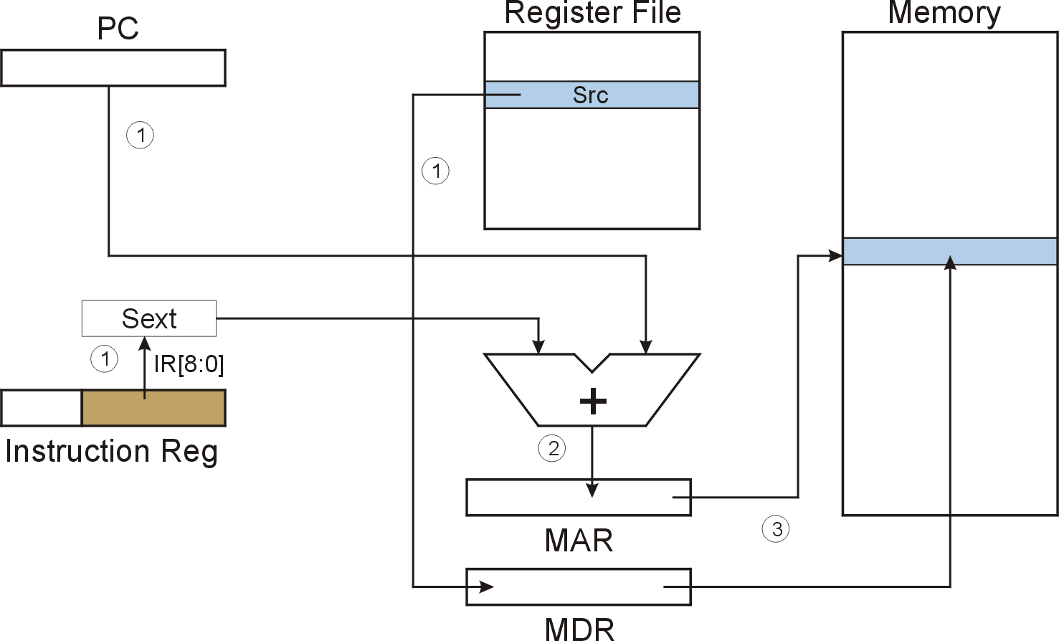
ST (PC-Relative)

Slide 15
Indirect Addressing Mode
With PC-relative mode, can only address data
within 256 words of the instruction.
  What about the rest of memory?
Solution #1:
  Read address from memory location,
  then load/store to that address.
First address is generated from PC and IR
(just like PC-relative addressing), then
content of that address is used as target for load/store.

Slide 16
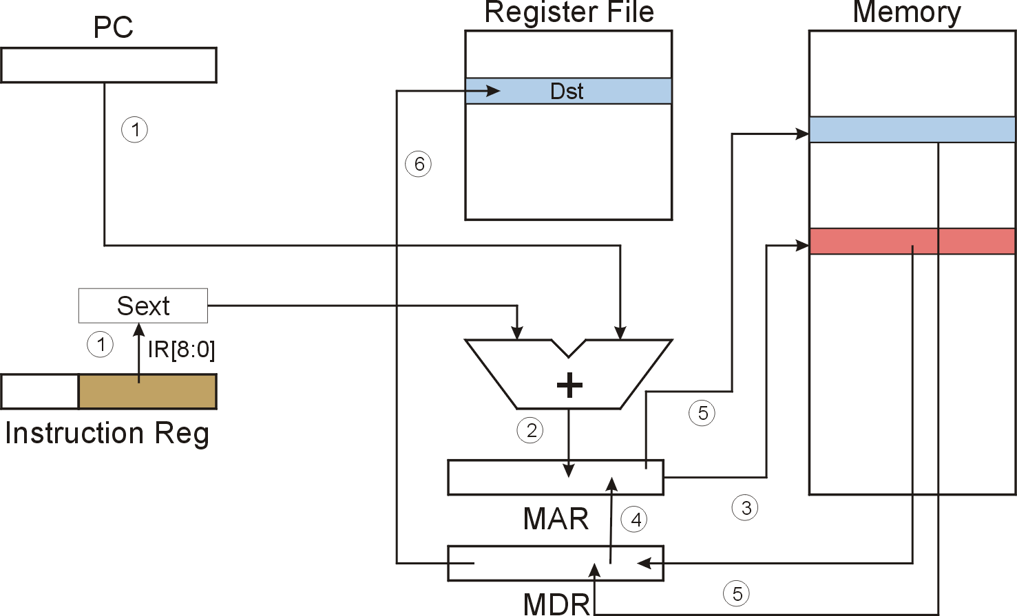
LDI (Indirect)

Slide 17
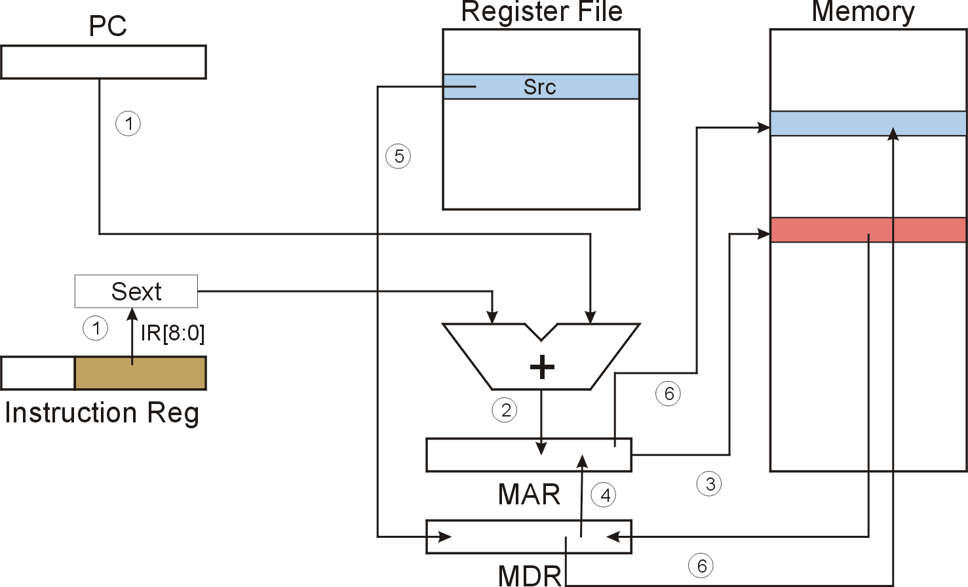
STI (Indirect)

Slide 18
Base + Offset Addressing Mode
With PC-relative mode, can only address data
within 256 words of the instruction.
  What about the rest of memory?
Solution #2:
  Use a register to generate a full 16-bit address.
4 bits for opcode, 3 for src/dest register,
3 bits for base register -- remaining 6 bits are used
as a signed offset.
  Offset is sign-extended before adding to base register.

Slide 19
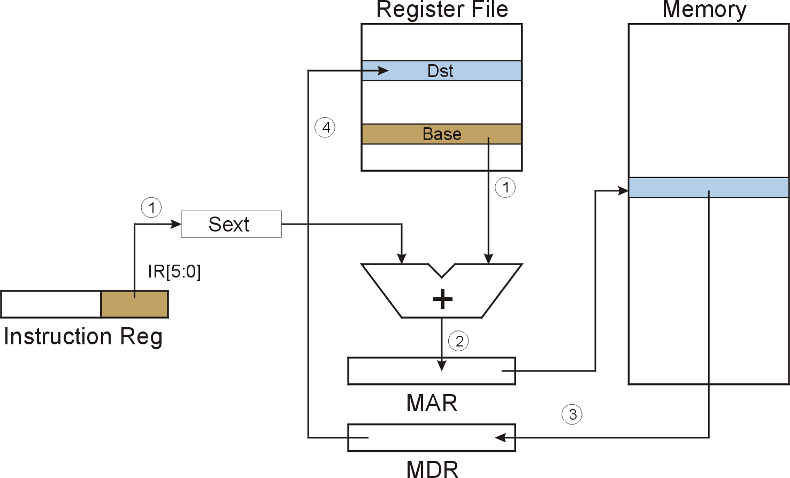
LDR (Base+Offset)

Slide 20

STR (Base+Offset)

Slide 21
Load Effective Address
Computes address like PC-relative (PC plus signed offset) and stores the result into a register.
Note: The address is stored in the register,
not the contents of the memory location.

Slide 22
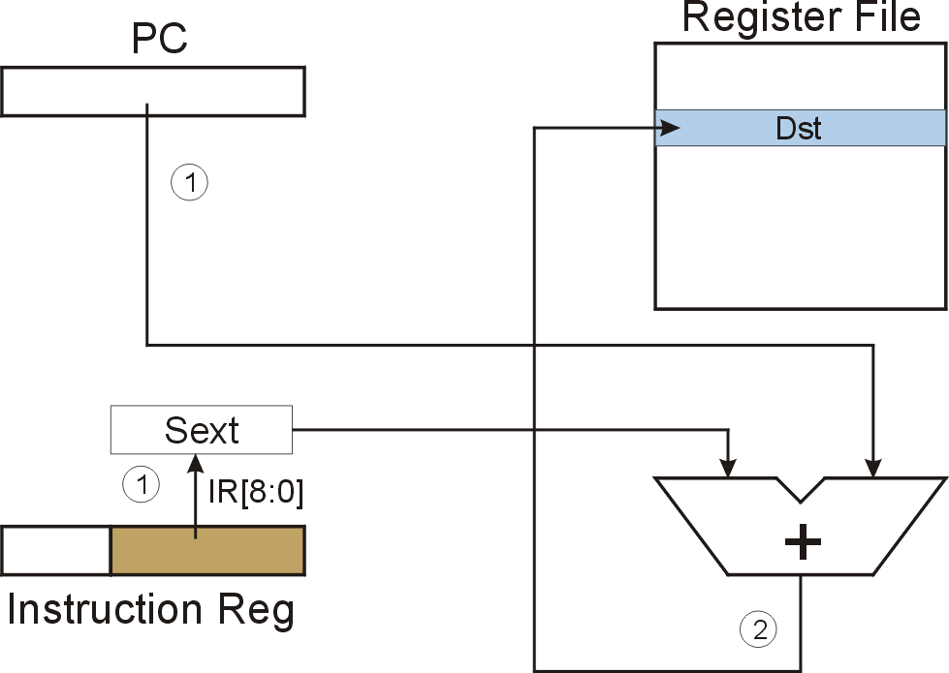
LEA (Immediate)

Slide 23
Example
Address | Instruction | Comments
x30F6 | 1 1 1 0 0 0 1 1 1 1 1 1 1 1 0 1
x30F7 | 0 0 0 1 0 1 0 0 0 1 1 0 1 1 1 0
x30F8 | 0 0 1 1 0 1 0 1 1 1 1 1 1 0 1 1
x30F9 | 0 1 0 1 0 1 0 0 1 0 1 0 0 0 0 0
x30FA | 0 0 0 1 0 1 0 0 1 0 1 0 0 1 0 1
opcode

Slide 24
Example
Address | Instruction | Comments
x30F6 | 1 1 1 0 0 0 1 1 1 1 1 1 1 1 0 1 LEA R1 (PC)-3 | Compute an address and load it into R1
x30F7 | 0 0 0 1 0 1 0 0 0 1 1 0 1 1 1 0
x30F8 | 0 0 1 1 0 1 0 1 1 1 1 1 1 0 1 1
x30F9 | 0 1 0 1 0 1 0 0 1 0 1 0 0 0 0 0
x30FA | 0 0 0 1 0 1 0 0 1 0 1 0 0 1 0 1
opcode

Slide 25
Example
Address | Instruction | Comments
x30F6 | 1 1 1 0 0 0 1 1 1 1 1 1 1 1 0 1 LEA R1 (PC)-3 | Compute an address and load into R1
x30F7 | 0 0 0 1 0 1 0 0 0 1 1 0 1 1 1 0 ADD R2 R1 I 14 | Add 14 to R1 and store in R2
x30F8 | 0 0 1 1 0 1 0 1 1 1 1 1 1 0 1 1
x30F9 | 0 1 0 1 0 1 0 0 1 0 1 0 0 0 0 0
x30FA | 0 0 0 1 0 1 0 0 1 0 1 0 0 1 0 1
opcode

Slide 26
Example
Address | Instruction | Comments
x30F6 | 1 1 1 0 0 0 1 1 1 1 1 1 1 1 0 1 LEA R1 (PC)-3 | Add -3 to PC and load that address into R1
x30F7 | 0 0 0 1 0 1 0 0 0 1 1 0 1 1 1 0 ADD R2 R1 I 14 | Add 14 to R1 and store in R2
x30F8 | 0 0 1 1 0 1 0 1 1 1 1 1 1 0 1 1 ST R2 -5 | Add -5 to PC, and store R2 at that address
x30F9 | 0 1 0 1 0 1 0 0 1 0 1 0 0 0 0 0
x30FA | 0 0 0 1 0 1 0 0 1 0 1 0 0 1 0 1
opcode

Slide 27
Example
Address | Instruction | Comments
x30F6 | 1 1 1 0 0 0 1 1 1 1 1 1 1 1 0 1 LEA R1 (PC)-3 | Add -3 to PC and load that address into R1
x30F7 | 0 0 0 1 0 1 0 0 0 1 1 0 1 1 1 0 ADD R2 R1 I 14 | Add 14 to R1 and store in R2
x30F8 | 0 0 1 1 0 1 0 1 1 1 1 1 1 0 1 1 ST R2 -3 | Add -3 to PC, and store R2 at that address
x30F9 | 0 1 0 1 0 1 0 0 1 0 1 0 0 0 0 0 AND R2 R2 I 0 | And 0 with R2 and store in R2
x30FA | 0 0 0 1 0 1 0 0 1 0 1 0 0 1 0 1
opcode

Slide 28
Example
Address | Instruction | Comments
x30F6 | 1 1 1 0 0 0 1 1 1 1 1 1 1 1 0 1 LEA R1 (PC)-3 | Add -3 to PC and load that address into R1
x30F7 | 0 0 0 1 0 1 0 0 0 1 1 0 1 1 1 0 ADD R2 R1 I 14 | Add 14 to R1 and store in R2
x30F8 | 0 0 1 1 0 1 0 1 1 1 1 1 1 0 1 1 ST R2 -3 | Add -3 to PC, and store R2 at that address
x30F9 | 0 1 0 1 0 1 0 0 1 0 1 0 0 0 0 0 AND R2 R2 I 0 | And 0 with R2 and store in R2
x30FA | 0 0 0 1 0 1 0 0 1 0 1 0 0 1 0 1 ADD R2 R2 I 5 | Add 5 to R2 and store in R2
opcode

Slide 29
Register Transfer Notation
To compactly express machine language instructions in mathematical format:
Rn => Register #n
M[0xFF] => Memory at address 0xFF
← => Transfer to
Examples:
R1 ← PC + (-3) =>
Compute the address PC-3 and load the address in R1
R2 ← M[R1 + 5] =>
Compute the address R1+5 and load the contents of that memory location into R2

Slide 30
Control Instructions
Used to alter the sequence of instructions
(by changing the Program Counter)
Conditional Branch
  branch is taken if a specified condition is true
    signed offset is added to PC to yield new PC
  else, the branch is not taken
    PC is not changed, points to the next sequential instruction
Unconditional Branch (or Jump)
  always changes the PC
TRAP
  changes PC to the address of an OS “service routine”
  routine will return control to the next instruction (after TRAP)

Slide 31
Condition Codes
LC-3 has three condition code registers:
N -- negative
Z -- zero
P -- positive (greater than zero)
Set by any instruction that writes a value to a register
(ADD, AND, NOT, LD, LDR, LDI, LEA)
Exactly one will be set at all times
  Based on the last instruction that altered a register

Slide 32
Branch Instruction
Branch specifies one or more condition codes.
If the set bit is specified, the branch is taken.
  PC-relative addressing:
  target address is made by adding signed offset (IR[8:0])
  to current PC.
  Note: PC has already been incremented by FETCH stage.
  Note: Target must be within 256 words of BR instruction.
If the branch is not taken,
the next sequential instruction is executed.

Slide 33
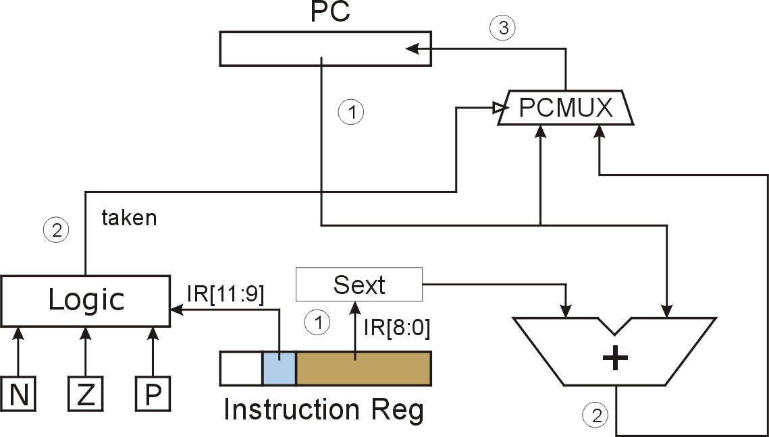
BR (PC-Relative)
What happens if bits [11:9] are all zero? All one?
Notes:
If all zero, no CC is tested, so branch is never taken. (See Appendix B.)
If all one, then all are tested. Since at least one of the CC bits is set to one after each operate/load instruction, then branch is always taken. (Assumes some instruction has set CC before branch instruction, otherwise undefined.)

Slide 34
Using Branch Instructions
Compute sum of 12 integers.
Numbers start at location x3100. Program starts at location x3000.
R1 ← x3100
R3 ← 0
R2 ← 12
R2=0?
R4 ← M[R1]
R3 ← R3+R4
R1 ← R1+1
R2 ← R2-1
NO
YES

Slide 35
x3000 | 1 1 1 0 | 0 0 1 0 1 1 1 1 1 1 1 1
x3001 | 0 1 0 1 | 0 1 1 0 1 1 1 0 0 0 0 0
x3002 | 0 1 0 1 | 0 1 0 0 1 0 1 0 0 0 0 0
x3003 | 0 0 0 1 | 0 1 0 0 1 0 1 0 1 1 0 0
x3004 | 0 0 0 0 | 0 1 0 0 0 0 0 0 0 1 0 1
x3005 | 0 1 1 0 | 1 0 0 0 0 1 0 0 0 0 0 0
x3006 | 0 0 0 1 | 0 1 1 0 1 1 0 0 0 1 0 0
x3007 | 0 0 0 1 | 0 0 1 0 0 1 1 0 0 0 0 1
X3008 | 0 0 0 1 | 0 1 0 0 1 0 1 1 1 1 1 1
x3009 | 0 0 0 0 | 1 1 1 1 1 1 1 1 1 0 1 0
x300A | 1 1 1 1 | 0 0 0 0 0 0 1 0 0 1 0 1

Slide 36
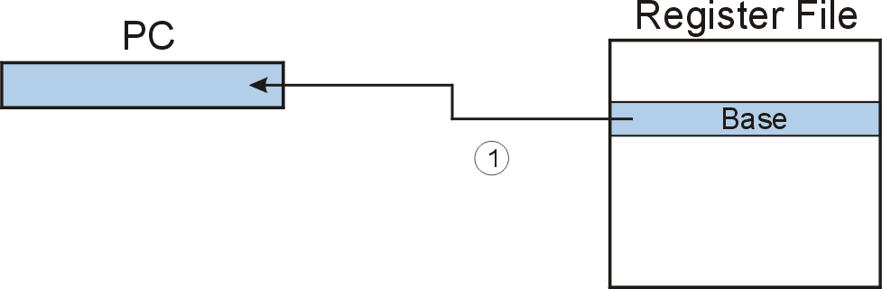
JMP (Register)
Jump is an unconditional branch -- always taken.
  Target address is the contents of a register.
  Allows any target address.

Slide 37
TRAP
Calls a service routine, identified by 8-bit “trap vector.”
When routine is done,
PC is set to the instruction following TRAP.
(We’ll talk about how this works later.)
vector | routine
x23 | input a character from the keyboard
x21 | output a character to the monitor
x25 | halt the program

